Slide 1
2022 Area III Speaking & Officer Election Room Assignments
MERRELL Center- 142- Extemp
MERRELL Center- 144- Extemp Prep
PDA’s- 211- Animal Science
PDA’s- 212- Plant Science
PDA’s- 213- Natural Resources
PDA’s- 214- Agribusiness
PDA’s- 215 – Ag Policy
PDA’s- 216- Tech & Comm
ESC 1650- Soil & Water
ESC- 2020- Jr. Prepared
ESC- 2770 (computer lab)- Area Officers Writing and Test
ESC- 2700A- Area Officer Panel Interviews & 3 one-on one interview stations
ESC- 2180- Area Interviews- 2 one-on one interview stations
ESC- 2090- Area Officer Holding
ESC- 2500- Area Officer Tabulation area (if needed)
ESC- 1200 BCG- Student and Teacher Hang out Area
ESC- 1200 J- WAR ROOM
ESC- 1030- Ag Science Fair

Slide 2
PARKING:
All Parking must take place in the large green area- you will get towed if parked in any reserved spot.
The Blue Circles are the entrances for various events. Please make sure to enter through these areas only.
3 entrance areas:
PDA’s (far left circle) – all 6 Sr. Prepared
Merrell Center ( middle circle) Extemp ONLY
ESC Staff Development (far right circle) Jr. Prepared, Soil & Water, Ag Science Fair, Area Officer Elections, Hang out Area, War Room

Slide 3
Area III Speaking and Officer Elections 1st Floor of the ESC
ESC 1650- Soil & Water
ESC- 1200 BCG- Student and Teacher Hang out Area
ESC- 1200 J- WAR ROOM
ESC- 1030- Ag Science Fair
1650

Slide 4
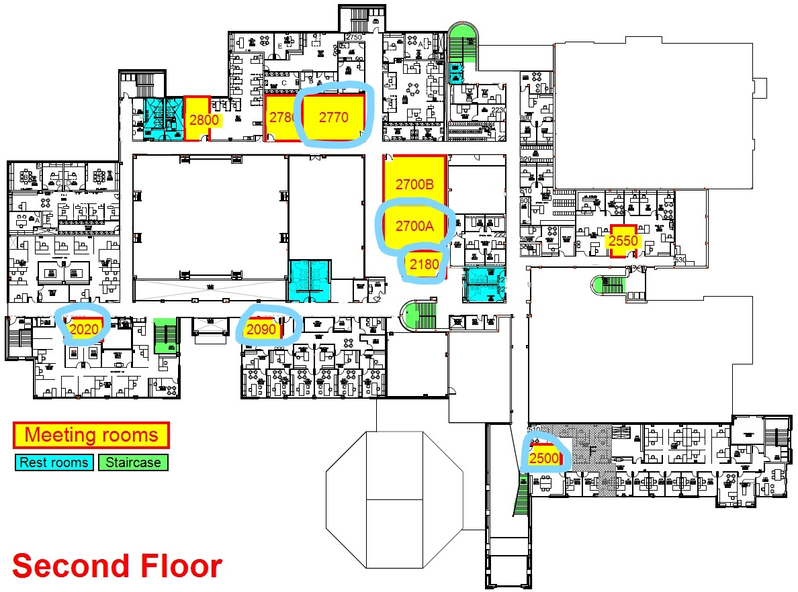
Area III Speaking and Officer Elections 2nd Floor of the ESC
ESC- 2020- Jr. Prepared
ESC- 2770 (computer lab)- Area Officers Writing and Test
ESC- 2700A- Area Officer Panel Interviews & 3 one-on one interview stations
ESC- 2180- Area Interviews- 2 one-on one interview stations
ESC 2780- Area Officer Holding
ESC- 2090- Area Officer Tabulation

Slide 5
Area III Speaking and Officer Elections PDA Rooms (across from Merrell)
PDA’s- 211- Animal Science
PDA’s- 212- Plant Science
PDA’s- 213- Natural Resources
PDA’s- 214- Agribusiness
PDA’s- 215 – Ag Policy
PDA’s- 216- Tech & Comm

Slide 6
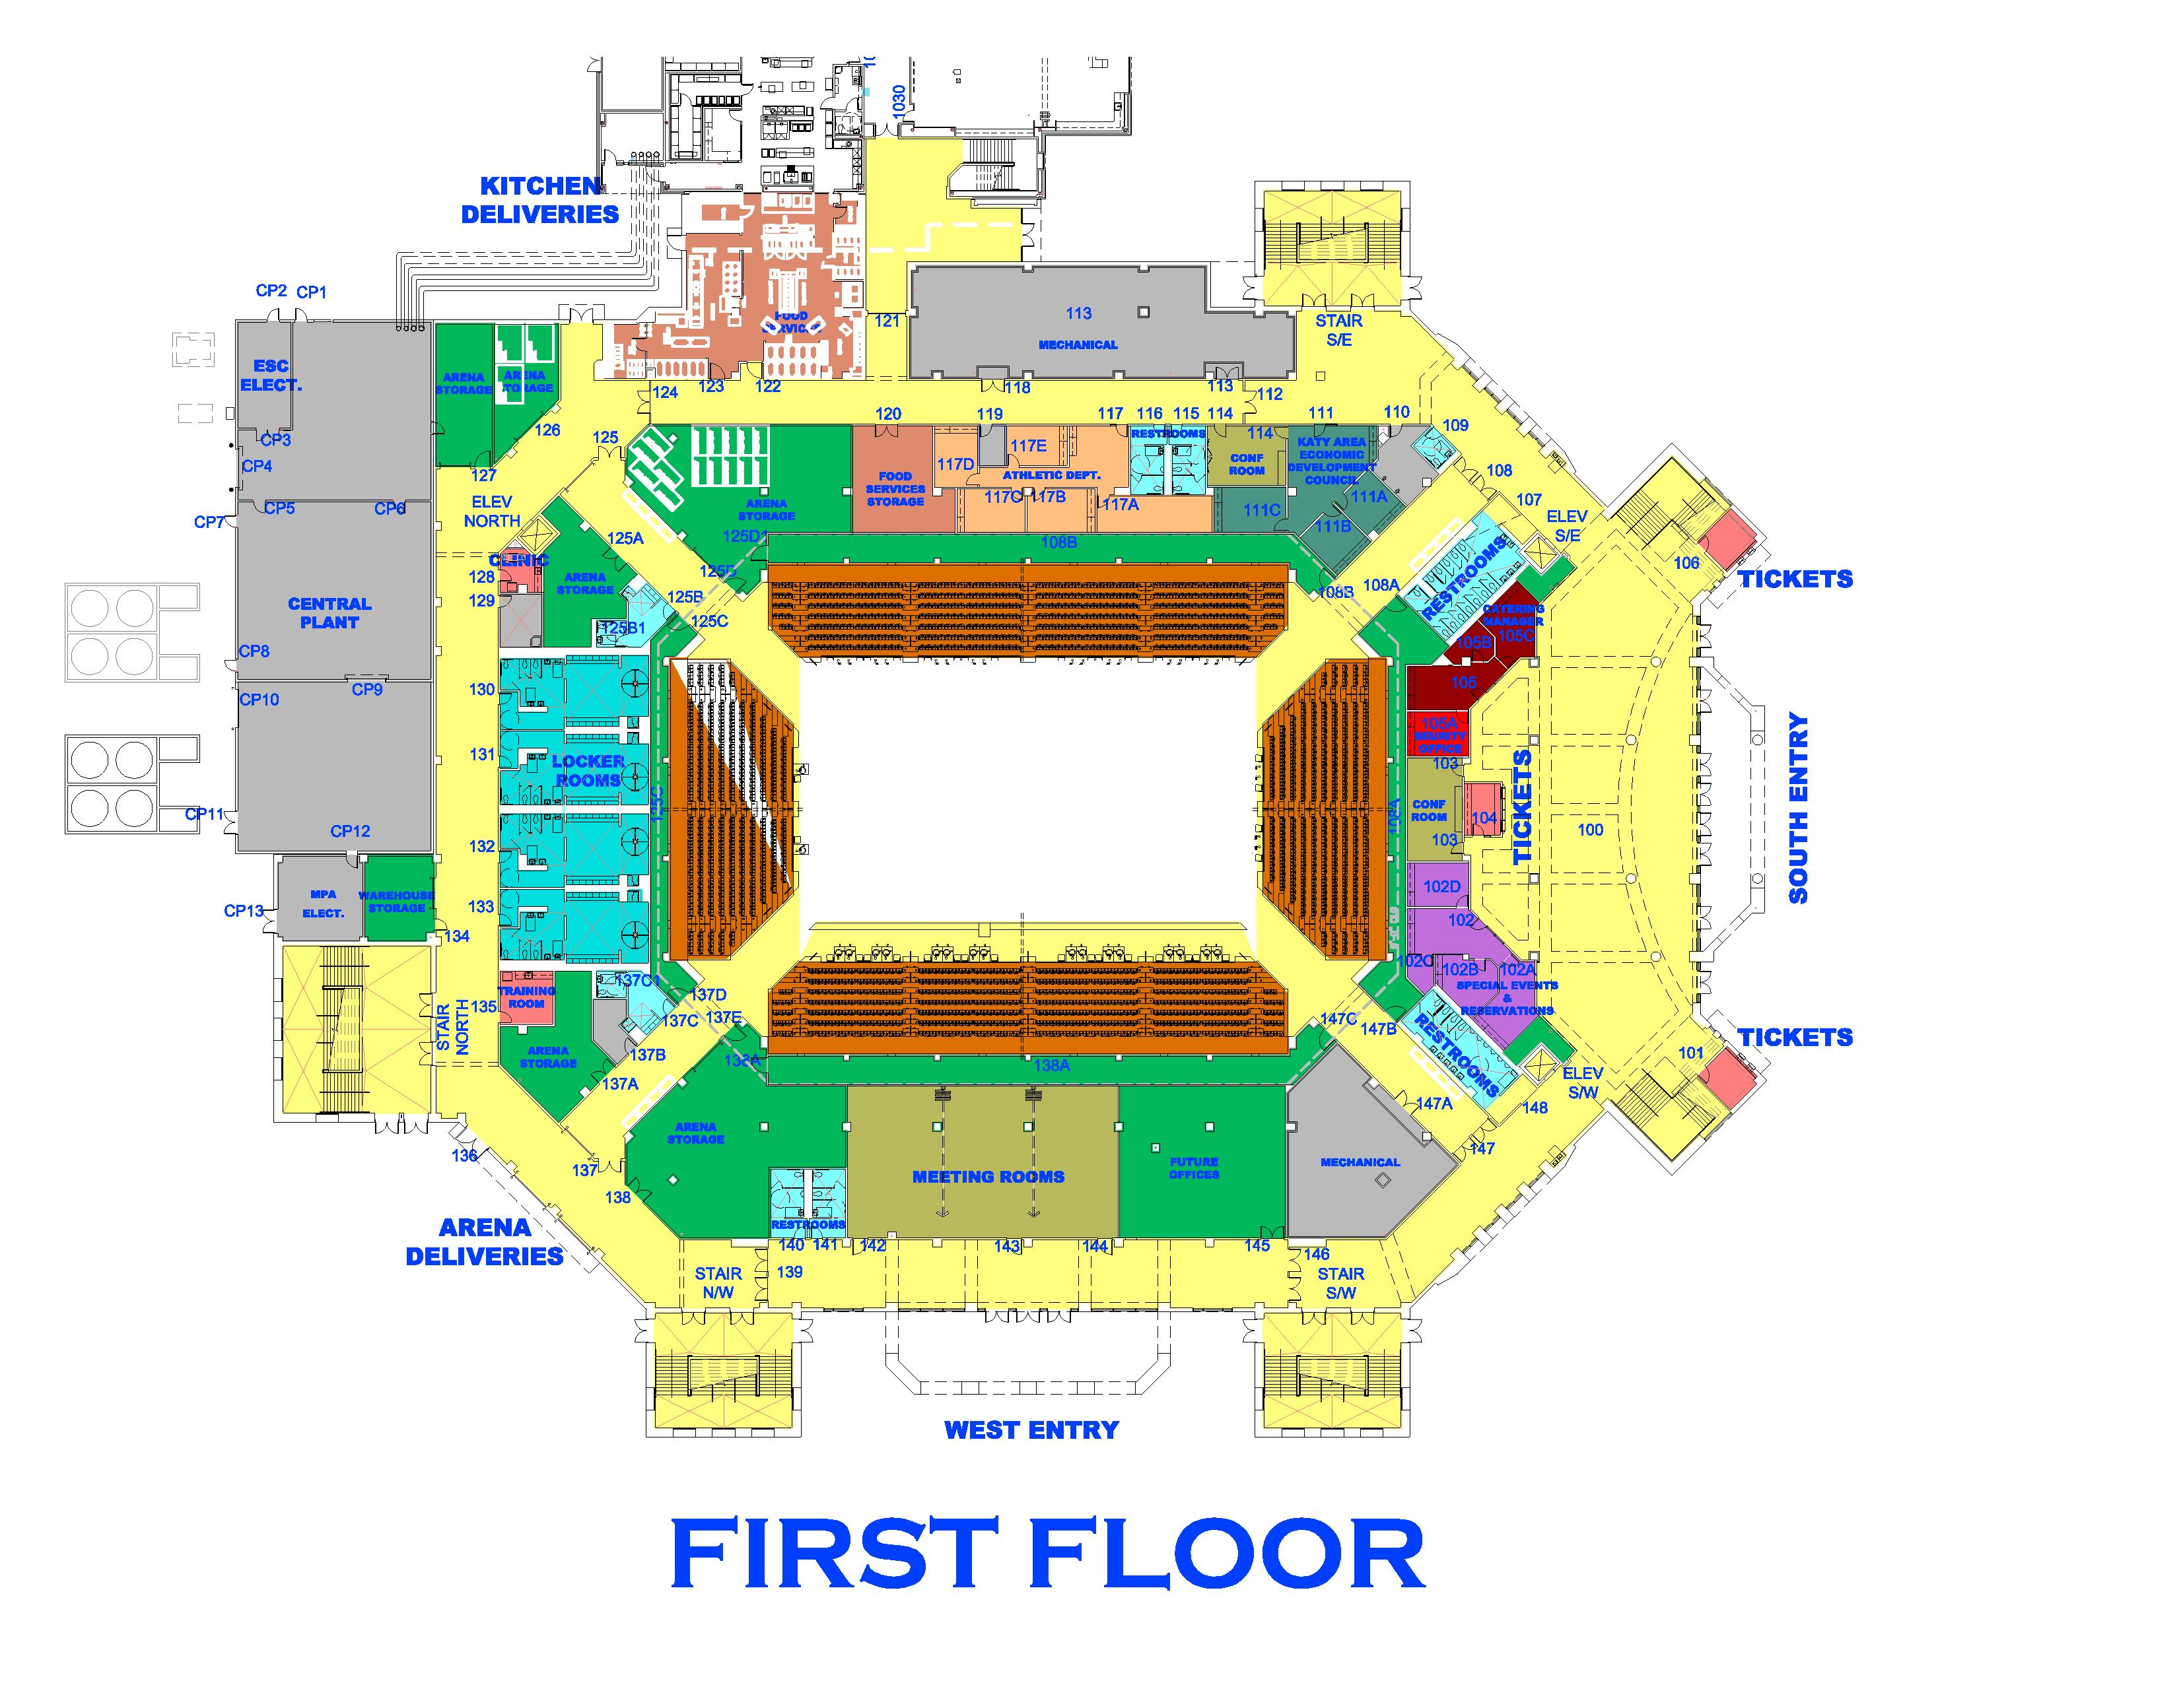
ESC Speaking Rooms
this way
Area III Speaking and Officer Elections Merrell Center Rooms
MERRELL Center- 142- Extemp
MERRELL Center- 143- leaving as a buffer area (will be empty)
MERRELL Center- 144- Extemp Prep
PDA Speaking Rooms
this way

